Slide 1
SHADOWFOX DATA ANALYST INTERNSHIP
Retail Sales Analysis
Beginner Level | Microsoft Excel | Madhav E-Commerce Sales Dataset
Prepared by
Jetti Srinesh Reddy
B.Tech — Artificial Intelligence
Amrita Vishwa Vidyapeetham, Amaravati
August 2026

Slide 2
PREFACE
Acknowledgement
🙏
With sincere thanks
I would like to express my sincere gratitude to ShadowFox for the opportunity to undertake this internship and work on a project of real business relevance.
I am also thankful to my mentors and coordinators for their consistent guidance and support throughout this experience. I confirm that the analysis, cleaning, and dashboard presented in this project were carried out independently by me, using the provided dataset and standard Excel techniques.
Finally, I am grateful to my institution, Amrita Vishwa Vidyapeetham, for supporting this internship as part of my academic journey in Artificial Intelligence.
Retail Sales Analysis — Beginner Level
2

Slide 3
BEGINNER LEVEL
Project Overview
🎯
Purpose
Analyze real e-commerce order data to understand retail sales performance, using standard spreadsheet techniques.
📊
Tool Used
The entire project was built in Microsoft Excel — from cleaning the raw data to the final dashboard.
🛒
Focus Area
Understanding overall sales performance: revenue, profit, monthly trends, categories, regions, and payments.
📈
Final Output
A simple, easy-to-read Excel dashboard combining KPIs, charts, business insights, and recommendations.
Retail Sales Analysis — Beginner Level
3

Slide 4
RAW DATA
Dataset & Data Structure
Orders
500 records
Details
1,500 records
Order ID
Order Date
Customer Name
State
City
Order ID
Amount
Profit
Quantity
Category
Sub-Category
Payment Mode
Combined using Order ID → merged table: 1,500 rows (analysis-ready)
Note: Repeated Order IDs are valid — one order can contain multiple product lines. These are not duplicate orders.
Retail Sales Analysis — Beginner Level
4

Slide 5
GETTING THE DATA READY
Data Cleaning & Preparation
1
Checked and corrected data types across all fields
5
Checked for genuine duplicate records
2
Kept Order ID as Text (it's an identifier, not a value)
6
Standardized column names for readability
3
Formatted Order Date correctly for chronological sorting
7
Organized the final data into a clean Excel table
4
Checked the dataset for missing values
This was a standard Excel-based data preparation process — no scripts or automation were used.
Retail Sales Analysis — Beginner Level
5

Slide 6
KEY METRICS
Business Performance at a Glance
₹437,771
₹36,963
5,615
500
₹875.54
TOTAL SALES
TOTAL PROFIT
TOTAL QUANTITY SOLD
TOTAL ORDERS
AVERAGE ORDER VALUE
Total Orders were calculated using unique Order IDs, rather than simply counting rows.
Retail Sales Analysis — Beginner Level
6

Slide 7
FROM DATA TO INSIGHT
Analysis & Key Findings
STRONGEST MONTH
WEAKEST MONTH
TOP CATEGORY (SALES)
Jan 2018
Jul 2018
Electronics
~₹61,632
~₹12,966
~₹166,267
TOP CATEGORY (PROFIT)
TOP SUB-CATEGORY
LEADING STATE
Clothing
Printers
Maharashtra
~₹13,325
~₹59,252
~₹102,498
Most-used payment mode by quantity: COD — approximately 2,456 units
Retail Sales Analysis — Beginner Level
7

Slide 8
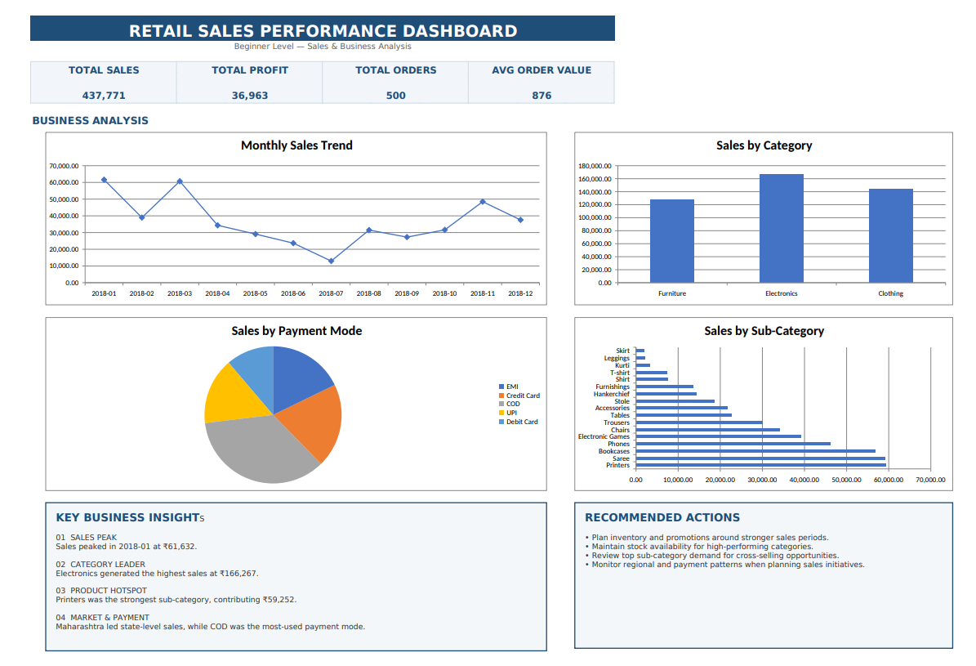
FINAL OUTPUT
The Excel Dashboard
Dashboard Components
KPI cards
Monthly Sales Trend
Sales by Category
Sales by Payment Mode
Sales by Sub-Category
Business Insights
Recommended Actions
Everything — sales performance, patterns, and next steps — is visible in a single, easy-to-read view.
Retail Sales Analysis — Beginner Level
8

Slide 9
CONCLUSION
What I Learned
How to combine related tables using a common key (Order ID)
How to clean, validate, and standardize real-world data
How to calculate key business metrics accurately
How to use charts to identify sales patterns
How to convert analysis into a simple business dashboard
“This project gave me a foundation in spreadsheet-based data analysis and helped me understand how raw business data can be converted into useful insights.”
Thank You

